Slide 1
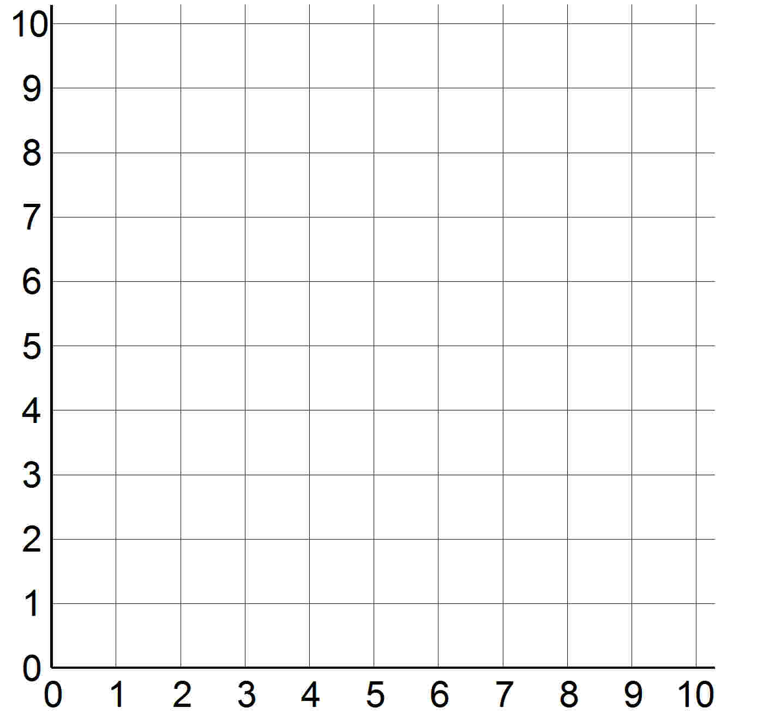
Read and plot co-ordinates in the first quadrant.
This is a
co-ordinate grid. We use it to plot locations on the grid, ‘points’, like a map.
y-axis
This line is the y-axis.
It goes up the grid, marking the
vertical position.
This line is the x-axis.
It goes across the grid, marking the horizontal position.
The origin is the point where the x and y-axes cross.
x-axis

Slide 2
Read and plot co-ordinates in the first quadrant.
This is the ‘point’ (2, 5). We write the x position first, then a comma, then the y position; then write brackets around both values.
It is
2 grid squares across from the origin and
5 squares up.
y-axis
What are the coordinates of this point?
(6, 1) Can you see why?
x-axis

Slide 3
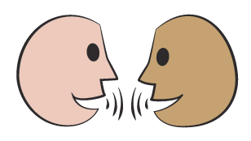
Read and plot co-ordinates in the first quadrant. Complete polygons by identifying missing vertices.
Let’s check…
These two points are two of the vertices of a square. Where might the other two vertices be?
y-axis
(2, 5)
(6, 5)
(2, 1)
(6, 1)
x-axis

Slide 4
Read and plot co-ordinates in the first quadrant. Complete polygons by identifying missing vertices.
There’s another solution, did anybody find it?
Let’s check…
(6, 9)
y-axis
(2, 5)
(10, 5)
(6, 1)
x-axis

Slide 5
Read and plot co-ordinates in the first quadrant. Complete polygons by identifying missing vertices.
These two points are two of the vertices of a right-angled triangle. Where might the third vertex be?
Let’s check…
(8, 8)
y-axis
(4, 3)
(8, 3)
x-axis

Slide 6
Read and plot co-ordinates in the first quadrant. Complete polygons by identifying missing vertices.
Is there another solution?
Let’s check…
(4, 8)
(8, 8)
y-axis
(4, 3)
x-axis

