Slide 1



Use multiplication sentences to describe an array and make links to division.
What can you see?
How many rows?
How many in each row?
How many altogether?
What number sentence could we write?
3 × 5 = 15
We can read this as 3 lots of 5, or 3 times 5.

Slide 2
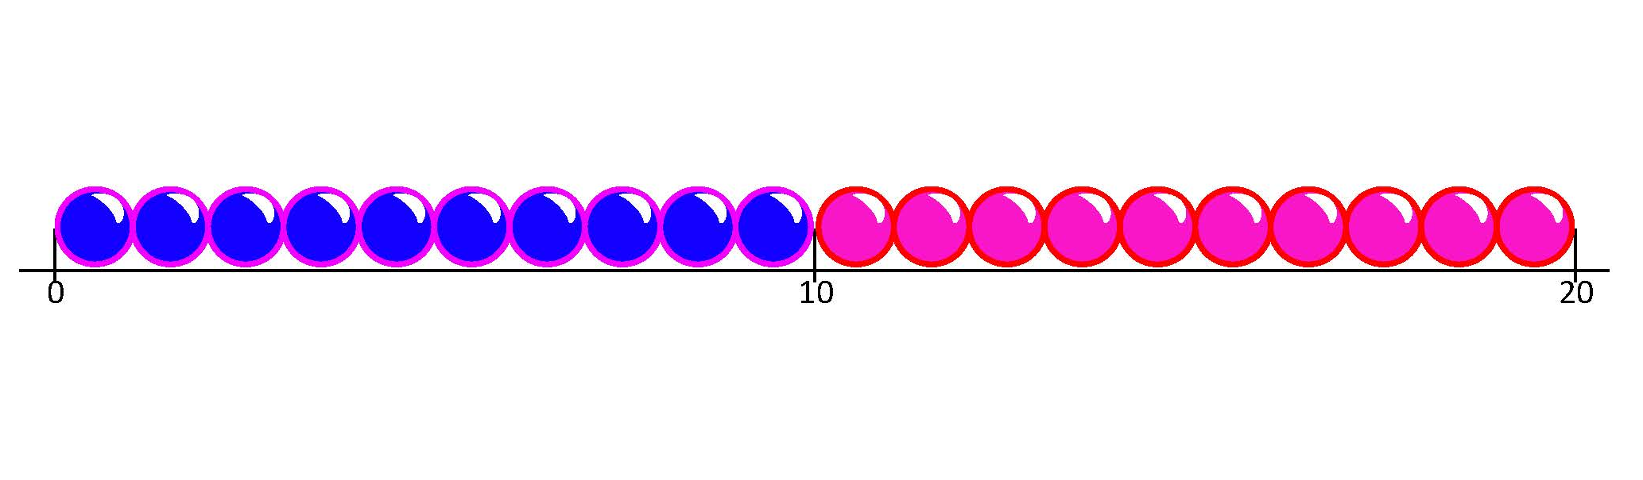
Use multiplication sentences to describe an array and make links to division.
How many lots of 5
are in 15?
□ × 5 = 15
We can count in 5s on a beaded line to find out what number goes in the box.
+5
+5
+5
5
10
15
3 lots of 5 in 15!

Slide 3
Use multiplication sentences to describe an array and make links to division.
The array has been rotated.
How many in each row?
How many rows?
What number sentence can we write?
We can read this as 5 lots of 3, or 5 times 3.
5 × 3 = 15

Slide 4
Use multiplication sentences to describe an array and make links to division.
3 × 5 and 5 × 3 have the same answer!
Let’s check back on the beaded line…
+5
+5
+5
5
10
15
3
6
9
12
15
+3
+3
+3
+3
+3
3 lots of 5 and 5 lots of 3 are the same…
Can you see why?

Slide 5
Use multiplication sentences to describe an array and make links to division.
5 rows of 10 counters,
5 × 10 = 50
10 rows of 5 counters, 10 × 5 = 50
5 lots of 10 is the same as 10 lots of 5!
The number of counters is the same!

