Slide 1

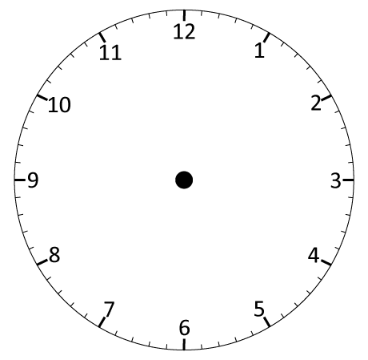
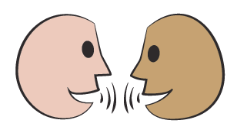
Read and write analogue and digital times; Convert between analogue and digital.
0
9
:
1
5
What will 09:15 look like on an analogue clock?
Let’s see…
The minute hand has travelled ¹/₄ of the way around.

Slide 2
Read and write analogue and digital times; Convert between analogue and digital.
0
9
:
1
2
5
0
What will the time be in
5 minutes?
How will each clock change?
Watch carefully -
analogue clock hands first;
then the digital time.
What changed?
What stayed the same?

Slide 3
Day 1: Read and write analogue and digital times; Convert between analogue and digital.
0
9
:
2
3
0
0
What will the time be in 10 more minutes? How will each clock change?
The minute hand is now half way round!
Let’s see…watch carefully!

Slide 4
Read and write analogue and digital times; Convert between analogue and digital.
0
9
:
3
0
5
What will the time be in 5 more minutes? How will each clock change?
09:35 or 25 to 10.
What do 35 and 25 add to?
Let’s see…watch carefully!

Slide 5
Read and write analogue and digital times; Convert between analogue and digital.
0
9
:
3
4
5
What will the time be in 10 more minutes? How will each clock change?
¹/₄ to 10
Can you see why?
Let’s see…watch carefully!

Slide 6
Read and write analogue and digital times; Convert between analogue and digital.
0
1
9
0
:
4
0
5
0
What will happen when we reach 10 o’clock?
Let’s see…watch carefully!
10:00, no minutes past the hour!

Slide 7
Read and write analogue and digital times; Convert between analogue and digital.
Each small division on the clock face represents just 1 minute….
How many minutes past 5 is this?
0
Seven minutes
past 5.
0
9
5
:
4
0
5
7

